Slide 1
SWE 4101
Introduction to Software Engineering
Lec - 1

Slide 2
Classroom Rules
Be on time
Be a good Listener
Raise your hand to speak
Ask questions
Share new ideas
Contribute to discussions

Slide 3
Google Classroom & Online Class Info
Join using Class Code
247uhoof
Use only IUT email to join

Slide 4







Shohel Ahmed
Professional Experience:
Educational Experience:
Islamic University of Technology (IUT)
Assistant Professor (Feb’2020 ~ )
Master of Engineering in Information Engineering
Inha University, Incheon, South Korea
Military Institute of Science & Technology
Assistant Professor (Sep’19 – Present)
BSc in Computer Science & Information Technology
Islamic University of Technology, Gazipur, Bangladesh
Kona Software Lab Ltd.
Sr. Project Manager (Jul’16 ~ Sep’19)
Samsung R&D Institute Bangladesh (SRBD)
Chief Engineer & Group Leader (Jan’15~ Jul’16)
Digital Imaging
Technical Lead (Dec’10~ Dec’14)
Platform Lab
Higher Secondary Certificate (HSC)
Secondary School Certificate (SSC)
Rangpur Cadet College, Rangpur, Bangladesh
Patents:
Sylhet International University
Assistant Professor (Jul’09 – Nov’10)
Lecturer (Apr’04 – Jul’04)
Shohel ahmed, Shake Md. Riazul Islam, Kwak Kyung Sup - “METHOD AND SYSTEM FOR FINGERPRINT-BASED PAYMENT” Application No.(Date) 1020170141375 (2017.10.27),Publication : KR101951125B1
BARI, A.S.M. Hossain, Shohel AHMED,AHSAN, Shegufta Bakht, Sadre Ala PARVEZ,AZIZ, Syeda Persia, Md. Tawhidul Islam CHOWDHURY- "ELECTRONIC DEVICE AND METHOD FOR PROVIDING INFORMATION THEREOF”
Publication number: 20150220247
Inha University, Korea
Research Assistant (Aug’07-Jun’09)
Intelligent Mobile Lab
For More info: https://cse.iutoic-dhaka.edu/profile/sohel/

Slide 5
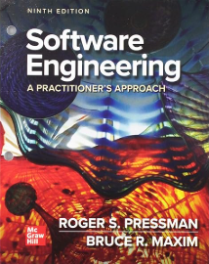
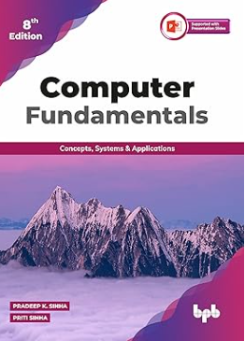
Important For you
Course Code: SWE 4101
Course Name: Introduction to Software Engineering
Recommended Books:
P. K. Sinha and P. Sinha, Computer Fundamentals, 8th ed. BPB Publications, 2020
R. S. Pressman and B. R. Maxim, Software Engineering: A Practitioner’s Approach, 9th ed. McGraw-Hill, 2019
Following the lecture slides & class will be good enough

Slide 6
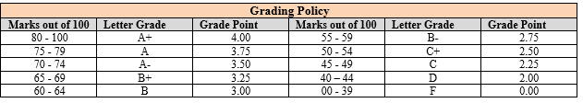
Assessment & Grading Policy
Course Assessment Method
Class participation | Quizzes and assignments | Mid-Term | Semester final
10% | 15% | 25% | 50%

Slide 7
Course Objective
Upon completion of this course, you will be able to:
01
Understand basic concepts of computer systems, hardware, software, and data representation.
02
Explain computer organization, networking, and emerging computing technologies.
03
Demonstrate understanding of software engineering principles, processes, and maintenance.

Slide 8
Course Outcome(CO)
01
Understand the core components of a computer system - hardware, software, and their interaction.
02
Explain basic computer organization, networking, and web technologies with real-world applications.
03
Illustrate key stages of the software life cycle and core software engineering concepts.

Slide 9
Outcome Based Education (OBE)
Course outcomes (COs) identify what the learner will know and be able to do by the end of a course or program.
Program Outcomes(POs) are narrower statements that describe what students are expected to know and be able to do by the time of graduation.
PO-1 | Engineering knowledge: Apply the knowledge of mathematics, science, engineering fundamentals and an engineering specialization to the solution of complex engineering problems.
PO-2 | Problem analysis: Identify, formulate, research and analyze complex engineering problems and reach substantiated conclusions using the principles of mathematics, the natural sciences and the engineering sciences.
PO-3 | Design/development of solutions: Design solutions for complex engineering problems and design system components or processes that meet the specified needs with appropriate consideration for public health and safety and of cultural, societal and environmental concerns.
PO-4 | Investigation: Conduct investigations of complex problems, considering experimental design, data analysis and interpretation and information synthesis to provide valid conclusions.
PO-5 | Modern tool usage: Create, select and apply appropriate techniques, resources and modern engineering and IT tools, including prediction and modeling, to complex engineering activities with an understanding of their limitations.
PO-6 | The engineer and society: Apply reasoning informed by contextual knowledge to assess societal, health, safety, legal and cultural issues and the consequent responsibilities relevant to professional engineering practice.
PO-7 | Environment and sustainability:Understand the impact of professional engineering solutions in societal and environmental contexts and demonstrate the knowledge of and need for sustainable development.
PO-8 | Ethics: Apply ethical principles and commit to the professional ethics, responsibilities and the norms of the engineering practice.
PO-9 | Individual work and teamwork: Function effectively as an individual and as a member or leader of diverse teams and in multidisciplinary settings.
PO-10 | Communication: Communicate effectively about complex engineering activities with the engineering community and with society at large. Be able to comprehend and write effective reports, design documentation, make effective presentations and give and receive clear instructions.
PO-11 | Project management and finance: Demonstrate knowledge and understanding of engineering and management principles and apply these to one’s work as a team member or a leader to manage projects in multidisciplinary environments.
PO-12 | Life-long learning: Recognize the need for and have the preparation and ability to engage in independent, life-long learning in the broadest context of technological change.

Slide 10
Outcome Based Education (OBE)
Exam Result is Not the Most Important Consideration by Employer
Communication (verbal & written)
Honesty/Integrity
Teamwork skills
Interpersonal skills
Strong work ethics
Motivation & initiative
Flexibility/adaptability
Analytical skills
Computer skills
Creativity
Organizational skills
Detail oriented
Leadership skills
Self confidence
Friendly/outgoing personality
Well mannered / polite
Tactfulness
CGPA
Sense of humor
Entrepreneurial skills/risk taker

Slide 11
Lecture Plan
Weeks | Topics
1 | Introduction to Computers and Basic Concepts
2 | Hardware Components and Peripherals
3 | Computer Architecture & Number Systems
4 | Software Concepts – Types and System Software
5 | Programming and Language Translators
6 | Networking and the Internet
7 | Web and Emerging Technologies
8 | Introduction to SW Engineering, Software Development Life Cycle (SDLC)
9 | Software Process Models
10 | Software Requirements Engineering, UI/UX
11 | Basics of SW design
12 | SW Testing
13 | Software Documentation
14 | Software Release and Maintenance

Slide 12
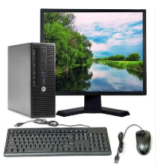
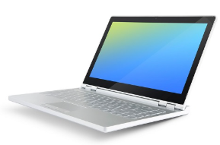
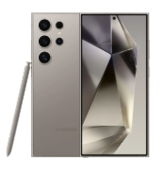
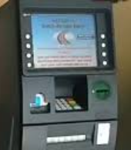
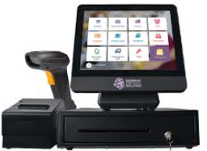
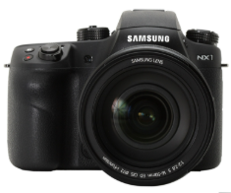
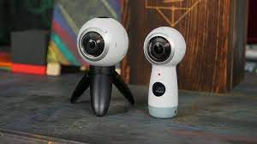
Meet Your Digital Brain: The Computer
Desktop
Laptop
Mobile
ATM
Point of Sale (POS)
Samsung Gear 360
Samsung NX1
A computer is an electronic device that takes input, processes it, stores data, and produces output to help us perform tasks.
Your smartphone today is millions of times more powerful than computers from the 1960s!

Slide 13

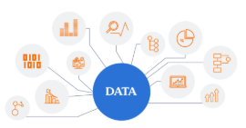

Computer
The word computer comes from the word “compute” which means, “to calculate”.
Thereby, a computer is an electronic device that can perform arithmetic operations at high speed.
A computer is also called a data processor because it can store, process, and retrieve data whenever desired.
The activity of processing data using a computer is called data processing
What are the activities?
Capture Data
Manipulate Data
Output Results

Slide 14
Data vs Information
Suppose IUT wants to understand the patterns of students arriving late to classes so that we can take steps to improve punctuality. You are asked to design a system to track late arrivals throughout the semester. What data should be collected about students arriving late? What information can be generated from that data to help the IUT authority?
Data can be collected:
  Student ID
  Date
  Time of arrival
  Course Code
  Teacher’s name
  Reason for being late
Information that can be generated from the data:
  Students who are frequently late
  Average delay per student or per class
  Days or subjects with the highest late arrivals
  Patterns over weeks or months (e.g., mornings vs. afternoons)
  Most/Least Frequent cause of late arrival

Slide 15
Core Features of Computers
    Speed: Processes data and performs calculations far faster than humans.
    Accuracy: Executes tasks with high precision when properly programmed.
    Storage: Holds vast amounts of data, from documents to multimedia.
    Connectivity: Links to networks and the internet for communication and sharing.
    Versatility: Performs a wide range of tasks across different industries.
    Automation: Automates repetitive tasks, improving efficiency.

Slide 16


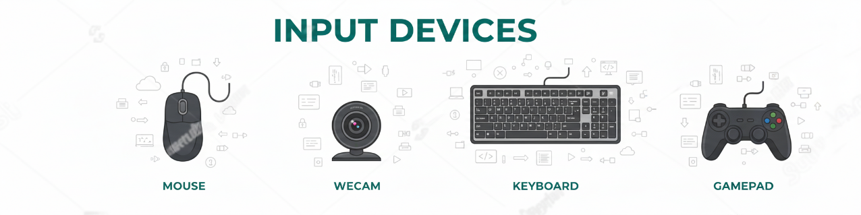
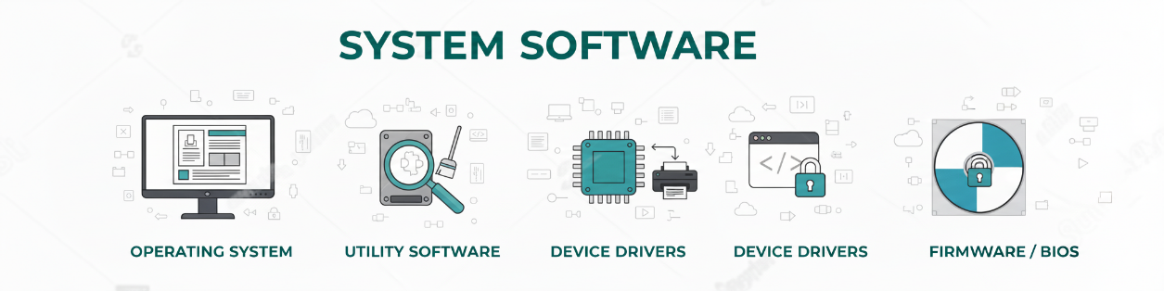
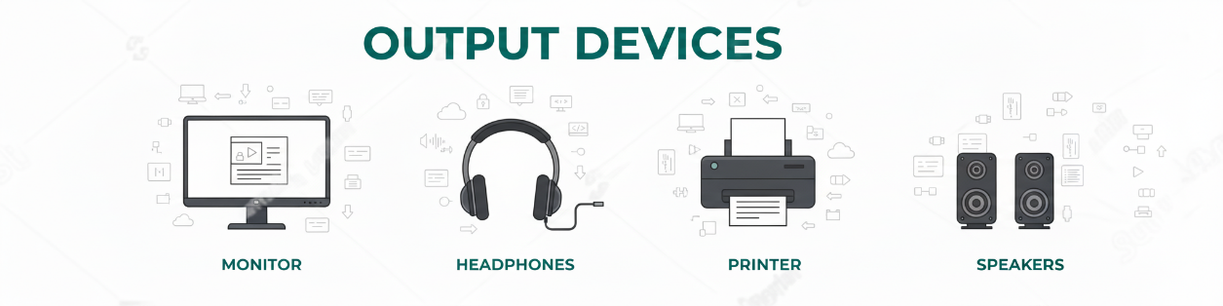
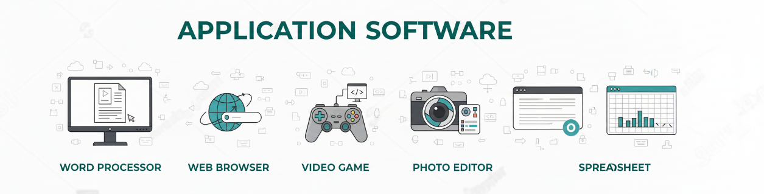
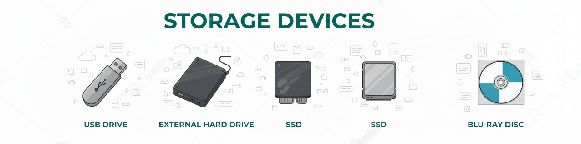
Key Components of Computer
instructions that direct the hardware to perform specific tasks.
physical parts of a computer

Slide 17
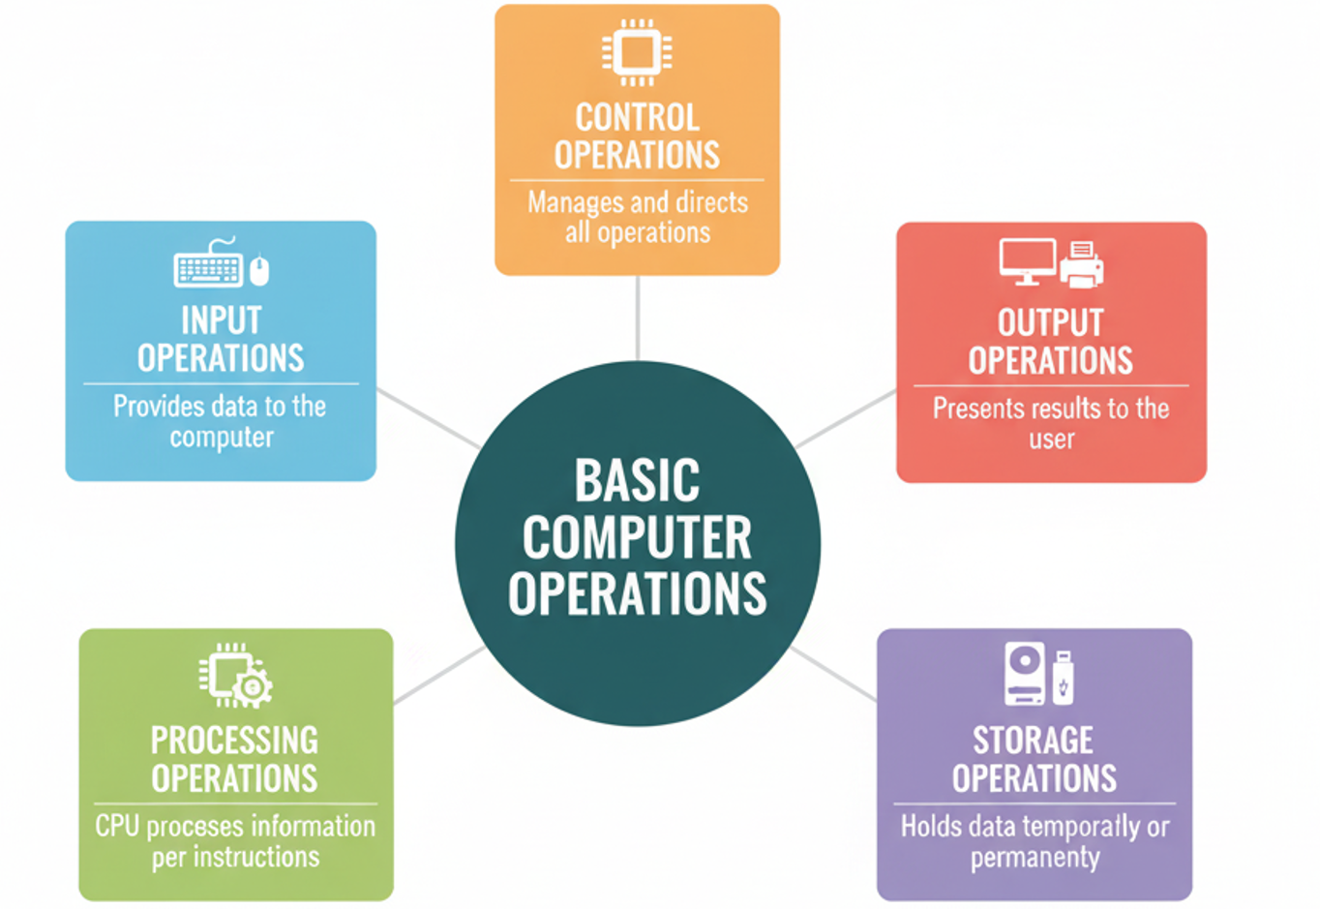
Basic Computer Operations

Slide 18
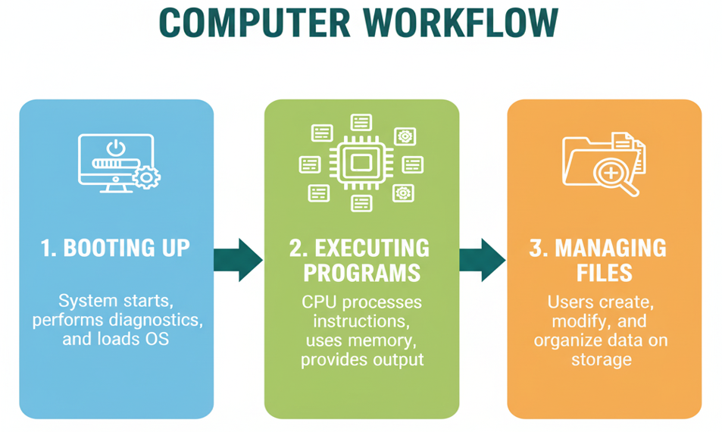
Computer Workflow

Slide 19
Events after you press the power button
Power-On Self Test (POST): The computer performs a self-check to ensure all hardware components are functioning correctly.
Boot Loader: The computer loads a small program called the bootloader, which in turn loads the operating system into memory.
Operating System: The operating system initializes various hardware components and prepares the system for use.
User Interface: Finally, the user interface (such as Windows Desktop or MacOS Finder) is displayed, allowing you to interact with the computer.

Slide 20
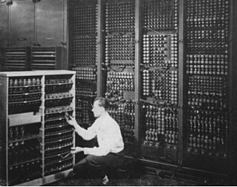
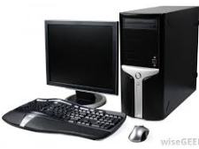
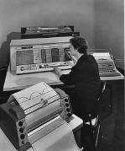
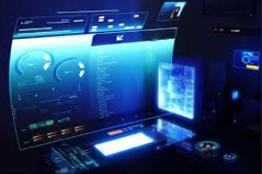
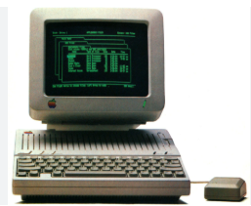
Generations of Computers
First Generation (1940s–1950s)
          Used vacuum tubes and magnetic drums.
          Large, expensive, and heat-intensive.
          Examples: ENIAC, UNIVAC I.
Fourth Generation (1970s–1980s)
          Microprocessors → PCs became common.
          Innovations: GUIs, software applications, internet access
Second Generation (1950s–1960s)
          Replaced vacuum tubes with transistors → smaller & reliable.
          Introduction of assembly language & high-level languages (Fortran, COBOL).
Fifth Generation (1980s–Present)
          Focus on AI, machine learning, quantum computing.
          Features: Parallel processing, intuitive interfaces, mobile & connected devices.
Third Generation (1960s–1970s)
          Integrated Circuits (ICs) replaced transistors.
          Smaller, faster, more reliable.
          Features: Operating systems, multiprocessing

Slide 21
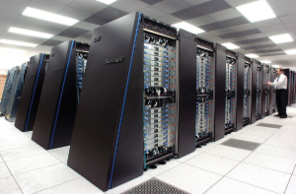
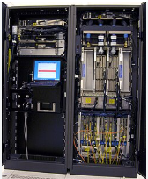
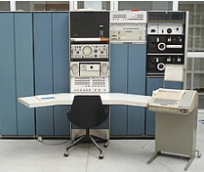
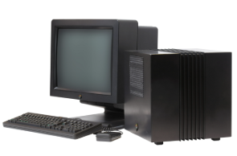
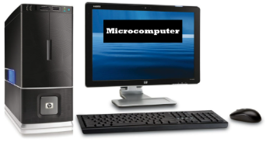
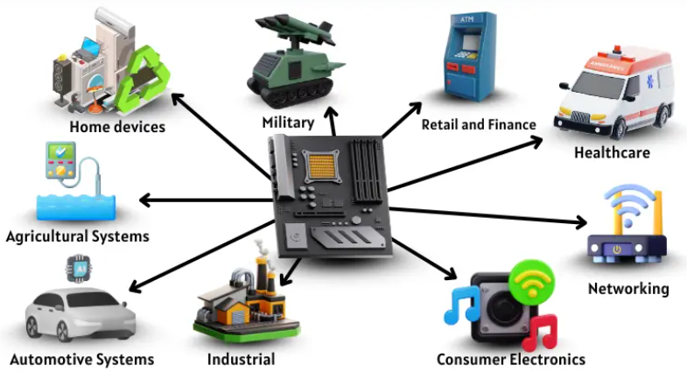
Types of Computers (by size)
Supercomputers: Extremely powerful, perform trillions of calculations/sec for tasks like simulations and data analysis. Examples: IBM Summit, Sunway TaihuLight.
Mainframe Computers: Large, powerful systems for handling bulk data processing, transactions, and critical applications. Examples: IBM zSeries, Unisys ClearPath.
Minicomputers: Mid-sized computers for small businesses and departmental tasks. Examples: DEC PDP-11, IBM AS/400.
Microcomputers: Personal computers for individual use, like desktops and laptops. Examples: Dell Inspiron, Apple MacBook.
Workstation Computers: High-performance PCs for technical or scientific tasks. Examples: HP Z Workstation, Dell Precision.
Embedded Computers: Specialized computers built into devices to perform specific tasks. Examples: Arduino, Raspberry Pi.

Slide 22
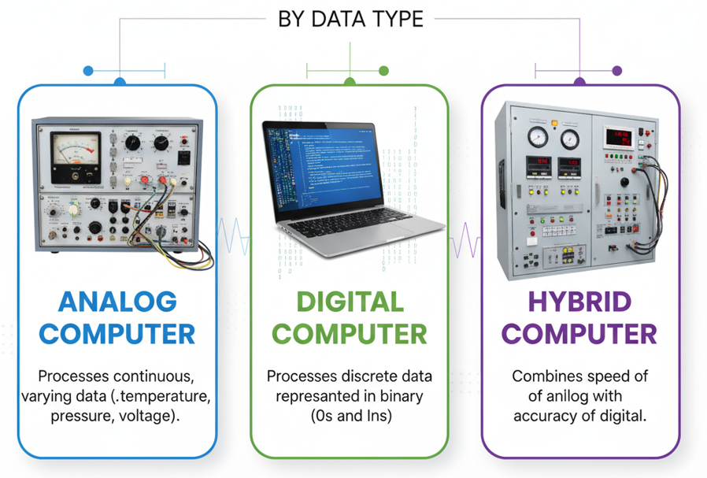
Types of Computers (by Data Type)

Slide 23
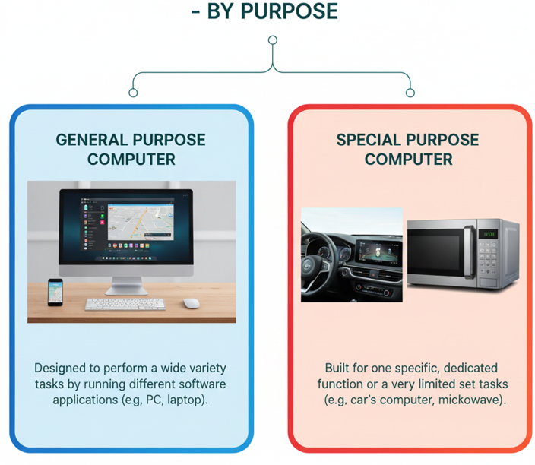
Types of Computers (by Purpose)

Slide 24






Limitations of Computer
No IQ
Can not think creatively or understand without input.
Vulnerability to Cyber Threats
Exposed to cyber threats like hacking, viruses, and malware, risking data integrity, operations, and finances.
Lack of Decision Making
They can analyze data but cannot make subjective or moral judgments.
Ethical and Moral Reasoning
computers cannot reason ethically or morally; they can only follow human-defined guidelines.
Human Dependency
Need Human programming, instructions and data input.
No feelings
Can not understand or express human feelings/empathy.

